Slide 1
DIPLOMATIC Global SECURITY SERVICES SWOT ANALYSIS
Justin Roth
Student #: 5896847
MGMT410: Strategic Management
Professor Jeremy Thiel
March 08, 2025

Slide 2

agenda
Introduction
SWOT Analysis
SWOT Analysis Quad Chart
Strengths
Learned From Strengths
Weaknesses
Learned From Weaknesses
Opportunities
Learned From Opportunities
Threats
Learned From Threats
Financial Information
Conclusion
Questions
Reference Page

Slide 3

INTRODUCTION
Diplomatic Global Security Services:
  The purpose of the company.
  Company Vision Statement.
  Company Mission Statement.
  The contracted positions the company provides.
Notes:
The new business venture that I will evaluate is Diplomatic Global Security Services. It is located in Reston, Virginia.
Its primary purpose is to provide unmatched contracted security services for overseas Department of State and Department of Defense construction projects. These new construction projects are for United States embassies, consulates, and military facilities. They also provide contracted security services for existing domestic facilities and new construction builds for DoD, DoS, DoJ, and DHS.
To become a leading provider of top-tier security solutions, delivering the highest level of protection to our fellow U.S. citizens supporting our government abroad and domestically.
While safeguarding our clients' interests, we take pride in providing tailored security solutions to a diverse range of U.S. government and military departments.
We provide security professionals in the positions of Cleared American Guards, Construction Surveillance Technicians, Team Leaders, and Site Security Coordinators. All personnel are required to have a Top-Secret security clearance, a minimum of three years of security experience, and proficient knowledge of physical and cyber security systems used by the U.S. government. Our CSTs are required to have and additional three years of experience in the field of construction. More than 95% of our staff are military veterans with most of our Cleared American Guards coming from the Marine Corps as former Marine Security Guards for U.S. embassies and consulates overseas.

Slide 4
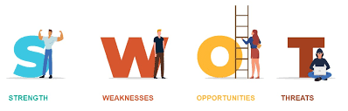
SWOT ANALYSIS
What is a SWOT analysis?
  This technique determines and defines strengths, weaknesses, opportunities, and threats.
Use a strategic map alongside a SWOT analysis.
Principles of a SWOT analysis.
Be sure to use a ”Balanced Scorecard.”
Notes:
The internal environment comprises strengths and weaknesses, while the external environment comprises opportunities and threats. These two environments comprise the SWOT analysis, a strategy for achieving a company’s objectives.
Strengths help achieve strategic objectives. Weaknesses are unhelpful, but once identified, they can be addressed and made helpful. Opportunities are external influences that help achieve strategic goals. Threats are influences that could prevent the achievement of strategic objectives.
It is essential to use a SWOT analysis alongside a strategic map for the company to distinguish and categorize the most critical SWOT factors by priority.
When preparing a SWOT analysis, it is imperative to be as realistic as possible, differentiate the company's current position from its desired future position, be specific, keep it short, and revisit each point multiple times to ensure the factor is clear and relevant.
A balanced scorecard comprises eight factors: financial performance, financial objectives and measures, environmental and competitive situations, customer objectives and measures, core capabilities, internal process objectives and measures, core competencies, and learning and growth objectives and measures. When using a balanced scorecard when creating a SWOT analysis, its intention is precisely what you perceive to keep an overall balance.
The essential objective of a SWOT is to be clear and concise from the beginning for it to be helpful.

Slide 5




SWOT Analysis quad chart
Sponsor Security Clearances
Best Compensation Packages in the Industry
95% Military Veterans
Prioritize Employee Well-Being
Only 3 Other Companies in the Field
Other Companies Unable to Staff All Projects
WEAKNESSES
THREATS
STRENGTHS
OPPORTUNITIES
U.S. Government Requires Overtime Pay
Taxpayers Unsupportive of Projects
Bidding Companies Dropped from 5 to 3
No Tangible Assets
5 Staff Members Managing 250 Employees
Overbidding
Notes:
Diplomatic Global Security Services sponsors security clearances, a quality that separates them from competitors. Another quality that separates DGSS from other competitors is that it offers the best compensation package in the industry. Military veterans are an internal resource that provides skilled and knowledgeable experience for the company's betterment. Something that DGSS does well is prioritize employee well-being over profit margin.
DGSS lacks tangible assets. The most impactful resource limitation is the management staff. Only five company staff members manage about 250 employees, which stretches management thin. While it is a strength that DGSS offers its employees the best compensation package in the industry, the company has sometimes lost bids on projects because its bid was too high.
Since there are only three other companies in government construction security worldwide, there is an excellent opportunity to step in and win more contracts. Because there are only three different companies, it would prove next to impossible to staff the number of contracts they could win.
One potential threat to this company is the recently changed regulation that requires companies that employ overseas contractors to pay for overtime. Most taxpayers do not support the position of the U.S. government to fund overseas diplomatic projects, which is a change in customer attitudes toward the company. Since the number of bidding companies on overseas security contracts has dropped from five to three there are likely to be additional competitors entering the industry.

Slide 6

STRENGTHS
Sponsor Security Clearances.
Best Compensation Packages in the Industry.
95% Military Veterans.
Prioritize Employee Well-Being.
Notes:
DGSS is the only company in the industry that will sponsor security clearances. Sponsoring a security clearance costs about $60,000 and takes anywhere from six months to one year to attain. The government reimburses the $60,000 cost for each clearance, but other companies would rather not wait at least six months to hire potential employees. DGSS sees this as an investment, and since it is the highest-paying company, employees are unlikely to go to another company once their clearance has been awarded.
DGSS provides its employees with the best compensation package in the industry. In addition to providing the best hourly wage, they offer the best contract bonuses, per diem, paid leave, and the best available housing in the area of the contracted project, along with other minor perks. They also provide business class travel when transiting to and from the employee’s home of record.
95% of this company’s employees are military veterans trained well in times of war and peace. Many have served overseas, and those who haven’t have likely been stationed overseas. These employees make an exceptional source of the specified experience this company needs. These employees are a skilled, knowledgeable, and invaluable resource for the company.
DGSS prioritizes their employee’s physical, mental, and emotional well-being over profits while other companies prioritize their profits over taking real care of their employees.

Slide 7

LEARNED FROM STRENGTHS
Go from 95% to 100% Military Veteran Employees.
Keep Employee Age Between 30 and 60.
Increase Minimum Security Experience from 3 to 5 years.
Notes:
I learned from the strengths that while DGSS has several, there is always room for improvement. In contract security, it is always an asset to have your employees be military veterans. Even though the military veteran employees are at 95%, the company can continue to work toward 100%.
Additionally, these veterans are between the ages of 25 and 75. It’s great that they can provide employment to these citizens. However, the company would be better served if it was more stringent on experience minimums and age maximums, especially overseas, when representing the United States on diplomatic projects. The company currently requires three years of experience in the security industry. They should increase that to five years' experience with a minimum age of 30 and a maximum age of 60. While this would narrow the window of acceptable employees, it would improve the quality of the employee and decrease the number of socializing-related problems that largely fall on the younger crowd and health-related issues that become more common over the age of 60.

Slide 8
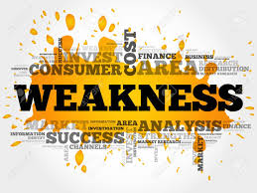

Weaknesses
No Tangible Assets.
Five Company Staff Members Managing 250 Employees.
Overbidding for Projects.
Notes:
DGSS does not have tangible assets such as intellectual property or proprietary technologies and does not have enough capital to consider them assets. Instead, its most significant assets are its expertise, experience, and business operations, which are intangible.
Another weakness of DGSS is that only five managers oversee 250 employees. While this gives them a more significant profit margin by keeping overhead low, this is an immense amount of work to be responsible for.
As was mentioned before as a strength, DGSS has the best compensation package in the industry. However, this also contributes to the weakness of overbidding government contracts. Because they pay more to their employees, they often lose contracts in the bidding process. They still retain substantial profit since they charge a minimum 300% over what they pay their employees, and right now, there are enough contracts to go around, but they do lose due to this aspect.

Slide 9
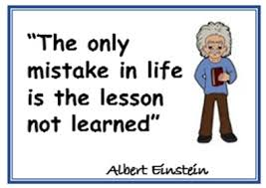
Learned from weaknesses
Build Capital.
Add Management Staff.
Overbidding is a Fair Trade for Employee Retention.
Notes:
Because the DGSS has no tangible assets, a good lesson learned would be to get some. The most realistic asset for this company to cultivate is capital. Start building slowly over time and compound it whenever possible.
Next, the company needs additional staffing to help manage the employees. This will have an impact on the profit margin by increasing overhead, but the sacrifice will help to facilitate a less stressful work environment and help the business run more smoothly. This will incrementally enable the business to grow and stabilize while having more hands to make light work.
Overbidding for contracts is an unfortunate byproduct of paying the employees well. If the company is profitable and continues to grow but loses contracts sometimes for taking care of their employees, then I would consider that a fair trade and categorize it as a cost of doing good business. The difficult aspect of this “fair trade” is going to be if the company can stick to it during lean profit years that are inevitable.

Slide 10

opportunities
Only Three Other Companies in the Field.
Other Companies Unable to Staff All Projects.
Notes:
There are only three other companies in the field of overseas diplomatic security. Since 50 overseas diplomatic construction projects are being conducted at any one time, this leaves plenty of opportunity for another company to jump into the industry and take advantage of the fact that there are few competitors and an underserved market for this service.
While I’m sure that these companies would love to be able to take on all of these projects, it is not feasible to retain all the employees needed to staff these projects. The reasons they would not be able to accomplish this is not necessarily because they don’t have the capacity, but because they don’t sponsor security clearances, they don’t pay well, to them an employee is just a number on a page, and they don’t prioritize the well-being of their employees over their profit margin. For these reasons, there is an emerging need for the service.

Slide 11

Learned from opportunities
Take Advantage of Them.
Recognize Other Companies’ Weaknesses and Use Them Against Them.
Make Small Improvements to Take Care of Employees.
Notes:
It’s important to recognize opportunities when they come and not let them pass you by. It can be a great advantage to recognize weaknesses in other companies and take the opportunity to use them to your advantage.
Other companies in this industry are known for treating their employees, not badly, but as if they were expendable. They don’t hold retention in high regard. They pay well, but not a well as they could. Why not take advantage of these weaknesses by improving on them just a little? You would be surprised what one more dollar an hour would do when you work 75-hour weeks, or when the team leader has the drive and motivation to find everyone the best possible housing in a third world country where an employee will most likely spend the other half of their time. Examples like these are not difficult to institute. It takes little effort that can have high rewards, and all that had to be done was to show someone that they matter to the company. For that loyalty is won, business can grow, and early retirement is on the horizon.

Slide 12
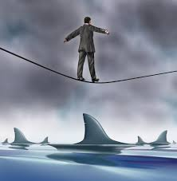
threats
U.S. Government Requires Overseas Contractors to Pay Overtime.
Most Taxpayers are Unsupportive of Overseas Government Projects.
Opposing Companies Dropped from Five to Three.
Notes:
One of the most credible threats to the company is that the U.S. government recently made it mandatory to pay overtime for overseas contractors. On average, an overseas security contractor works 60 hours a week. This has a significant effect on the company’s position when bidding on new contracts. While this regulation is the same for all companies in the industry, the result of this regulation will have a larger effect on smaller companies like DGSS.
Another threat is that most taxpayers are unsupportive of overseas diplomatic construction projects because, however big or small, they add to the tax burden in the U.S. These projects make up a multi-billion-dollar industry worldwide that many feel could be better budgeted for domestic use. This is the current “customer” attitude toward the company; however, the real customer is the U.S. government since they are the entity that pays the bill. But they elect the President who appoints the government that hires the company.
Opposing companies that bid on overseas construction security projects have dropped from five to three. Since there are a surplus of these projects several entities are beginning to start steps to become an approved bidder for these projects. This would make them emerging competitors and a possible threat to the company.

Slide 13
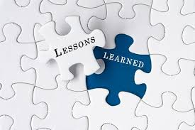
Learned from threats
Evaluate Threats to Prepare Your Company.
Bids Must be Exact to the Dollar.
Cut Taxpayer Dollars Spent.
Notes:
The beneficial aspect of conducting the SWOT to evaluate your threats is exactly that. You evaluate your threats. If you can identify and evaluate your threats then you can anticipate them, prepare your own company for the incoming issues, and with proper planning and management organization, repel them.
In this case, concerning overtime pay to that extent that company must ensure that they bid on there first project after a pristinely exact assessment at the absolute lowest acceptable cost and not one dollar below. Eventually a bid will be won one way or another because other companies cannot cover them all. It will ensure that there is enough money to pay for overtime and still have enough profit to set aside some capital.
There is not much to be done about the threat from taxpayers. The U.S. government decides how much they spend on these projects, and they spend billions. It would, however, go a long way with the taxpayer to cut spending on these projects. There is no reason they should cost a billion dollars a piece in some cases. Almost every project can be completed for less than $400 million, but many can be completed for between $100 - $200 million.

Slide 14
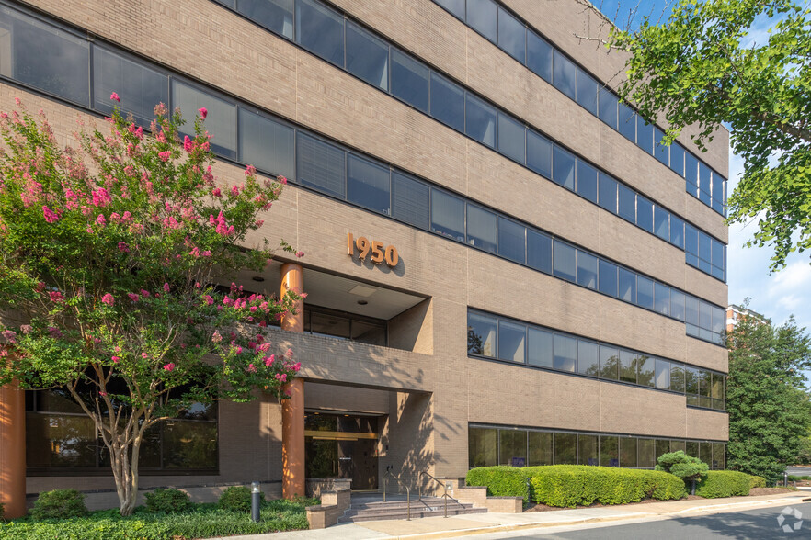
Financial information
Potential Office Space in Reston, VA.
Notes:
The financial information here shows that the total start-up cost of Diplomatic Global Security Services equal about two and a half million dollars. This amount also includes the salaries and benefits for all employees for the first year. The minimum first bid for the first contract with the minimum-security team size would be five and a half million for every year the project is operating. This is because the average bid is 200% over the cost of the contracted employees for every hour worked. Projects typically last at least four years with many going five to six years and a few that go from seven to ten years.
This means that within the first year the company would recover all startup costs, cover the first year of everyone’s compensation package, and still make a three-million-dollar profit. Expenses would cost two and a half million dollars every year with a three million dollar profit every year, and that is one bid for one project. Now, these are just rough numbers. The company could save more money by having management work remotely without a brick-and-mortar office space, and there may be several expenses that weren’t thought of. However, even if the numbers are off by 50% the company is still making a 1.5 million dollar profit every year. This is why government contracting is so lucrative if the company can get past all the bureaucratic red tape.
The start-up funds would come from a simple bank loan to get started. Once one bid is won there will be enough to pay the bank back in full. Getting the bid is the key, but as you can see, the typical bid and profit margin could be cut in half, and you would still be able to pay the loan off in two years, pay everyone a healthy salary and bonus, and in year three you would start turning a profit for the company. That’s only if you the loan doesn’t get paid off sooner.

Slide 15

CONCLUSION
Will you continue your business venture?
The Answer is a Resounding YES!
Compound Strengths, Recognize Weaknesses, Take Advantage of Opportunities, and Prepare for Threats.
SWOT Analysis is an Invaluable Tool.
Notes:
If I can manage to underbid my competitors by minimizing my overhead, gain a loyal network of dedicated contracted employees by sponsoring their clearances and paying better than my competitors, win just one contract, and make at least a one-million-dollar profit a year for a minimum of two years after paying off the loan within the first two years; then the question is why wouldn’t I continue my business venture?
By compounding the strengths, recognizing and improving on weaknesses, taking advantage of opportunities, and being as prepared as possible for incoming threats; there is money to be made for those with the experience, the patience, and the drive to wade through 1-2 years of processing paperwork to qualify for the right to make bids. One strategically, well-organized, winning bid could set someone up for a comfortable retirement. Anything after that is just icing on the cake.
The SWOT analysis proved to be an invaluable tool when evaluating the strategic standpoint of a company. Thank you for your time.

Slide 16

QUESTIONS
Notes:
DOES ANYONE HAVE ANY QUESTIONS?!

Slide 17

References
1950 Roland Clarke PL, Reston, VA 20191 - 1950 Roland Clarke PL | LoopNet. (2025, February 11). LoopNet. https://www.loopnet.com/Listing/1950-Roland-Clarke-Pl-Reston-VA/32232641/
Bean-Mellinger, B. (2019, March 9). The average cost per month for office supplies. Chron - Small Business. https://smallbusiness.chron.com/average-cost-per-month-office-supplies-12771.html
Bureau of Overseas Building Operations. (n.d.). U.S. Department of State. Retrieved March 3, 2025, from https://www.state.gov/bureaus-offices/bureau-of-overseas-buildings-operations/
Calculate your startup costs. (n.d.). U.S. Small Business Administration. https://www.sba.gov/business-guide/plan-your-business/calculate-your-startup-costs
Clear Escort Services - IDS International. (2025, February 5). IDS International. Retrieved March 3, 2025, from https://idsinternational.com/security-services/
Interiors, O. (n.d.). What does office equipment cost. https://www.officeinteriors.ca/office-technology/what-does-office-equipment-cost/
Shewan, D., & Shewan, D. (2024, July 16). How to do a SWOT Analysis (With examples &#038; free template!). WordStream. Retrieved March 3, 2025, from https://www.wordstream.com/blog/ws/2017/12/20/swot-analysis
Team, C. C. (2024, June 5). How to estimate utility costs for a small business. Constellation Residential and Small Business Blog. https://blog.constellation.com/2021/02/25/how-to-estimate-utility-costs-for-a-business/
Witcher, B. J. (2020). Absolute Essentials of Strategic Management. In Routledge eBooks. https://doi.org/10.4324/9780429430794

